Slide 1
Online Sales Management System
Software Testing Final Submission
63
100%
Final testing presentation built from the recorded execution results and supporting artifacts. 63 / 63 cases executed, 56 pass, 7 fail, 4 confirmed open defects.
Total cases
Executed
4
7
Team Hoang Van Thien Nguyen Thanh Dat Le Quang Duy
Live issues
Current fail cases
Repository: github.com/Alucard30Dec/Online-Sales-Management-System

Slide 2
01 Risk-Based Scope
System Surfaces And High-Risk Areas
The scope is centered on business-critical flows where defects can affect permissions, inventory, transaction status, or reporting.
Highest-Risk Modules - Authentication and permission boundaries - Product import, stock, and inventory movement - Purchase and invoice transaction flows - Reports and public catalog correctness
Admin UI
Public Catalog UI
Authentication, roles, products, purchases, invoices, reports, and stock operations.
Search, sorting, product detail access, and customer-facing catalog behavior.
Health API
Catalog API
Environment readiness smoke used to validate API availability before deeper runs.
Filtering, paging, sort, and boundary behavior through Newman collection runs.
Why this matters These areas can create false stock, invalid revenue records, or unauthorized access if they break.

Slide 3
02 Strategy And Evidence Model
From Test Design To Recorded Evidence
This section shows how scenario design, execution outputs, and defect tracking were kept in one consistent chain.
Approach - project-specific audit instead of template-only planning - black-box execution with white-box-informed edge cases - manual UI validation plus API regression plus targeted UI automation
Evidence Chain Each key claim in the report can be followed from test design to execution output, defect logging, and the linked GitHub issue when a failure was confirmed.
Scenario
Test Case
Execution
Evidence
Defect Log
GitHub Issue
Review point The deck does not rely on summary labels alone. Each important result is backed by a visible runtime artifact and, when failing, by a tracked GitHub issue with severity and priority.

Slide 4
03 Coverage Snapshot
Coverage Is Complete, Ownership Is Clear
The case set is wide enough to cover the required scope and explicit enough to show that the UI workload was split without overlap.
42
63
44 UI / 19 API
100% mapped
Documented scenarios
Total test cases
Design split
Scenario-to-testcase coverage
Owner Allocation
Hoang Van Thien
17 UI cases
Le Quang Duy
14 UI cases
Nguyen Thanh Dat
13 UI cases
All three members stay above the 10-UI-case threshold required by the brief, and the current ownership split sums cleanly to 44 UI cases.

Slide 5
04 Automation Implementation
Automation Supports The Manual Baseline Instead Of Replacing It
The automation layer adds repeatable UI and API checks while final status still depends on recorded runtime behavior.
.NET UI Suite - .NET 8, xUnit, Selenium - Page Object Model - shared settings, waits, and screenshot helper
API Suite - Postman collection + Newman - text and XML runner artifacts - execution stored in submission package
Demonstrated Flows - TC-UI-AUTH-001 on Edge - TC-UI-IMP-002 on Chrome - TC-API-HLT-001 in Newman - focused fail-case comparison in result view
Execution principle Automation is used as bonus evidence and repeatable smoke support. Final status still depends on runtime behavior, visible screenshots, runner outputs, and linked final-result records.

Slide 6
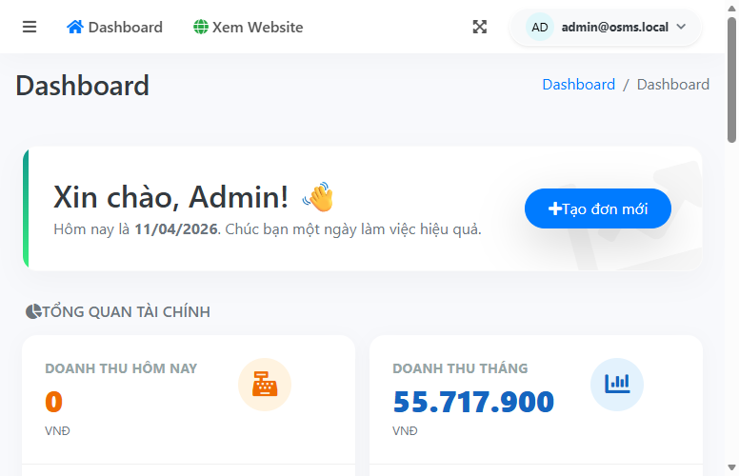
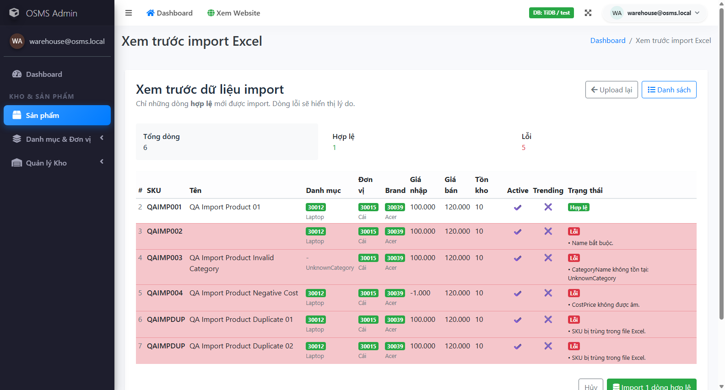
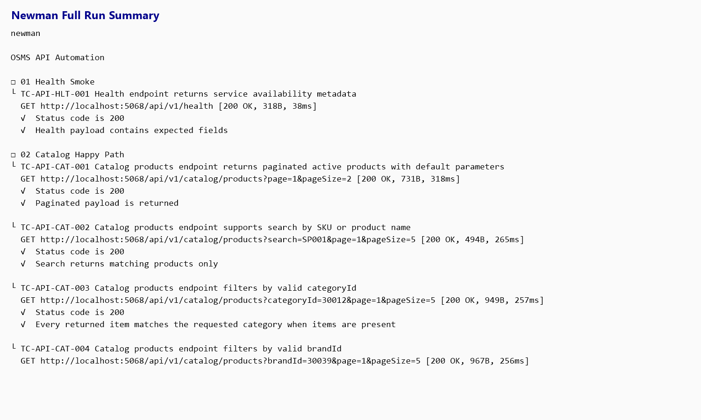
05 Real Execution Evidence
The Deck Uses Real Screenshots And Runner Artifacts
This slide proves that pass and fail statuses are backed by visible runtime output rather than summary claims.
Evidence rules - 63 / 63 cases executed - 0 cases remain Not Run - pass status requires runtime proof - fail status requires mismatch plus evidence Fail evidence in scope - purchase validation banner defect - import confirm defect - invoice create defect - invoice cancel defect
TC-UI-AUTH-001 pass on focused login smoke
TC-UI-IMP-002 preview shows 6 / 1 / 5 counts
Newman full run proves API regression passed 19 / 19

Slide 7
06 Result Comparison
Expected Result, Actual Result, Status, Then Evidence
This slide shows how each status in the final workbook was justified through runtime behavior rather than summary labels alone.
TC-UI-AUTH-001
Pass
TC-UI-IMP-002
Pass
Valid admin login reaches dashboard
Import preview shows valid and invalid counts
Expected Admin login must redirect to dashboard without validation error.
Expected Preview must show row counts and row-level validation info.
Actual Chrome and Edge smoke reruns both reached the dashboard.
Actual Preview showed 6 total, 1 valid, and 5 invalid rows.
Evidence: edge-auth-smoke.trx
Evidence: import-preview-rerun.trx
TC-UI-PUR-002
Fail
TC-UI-INV-001
Fail
Readable supplier validation should be shown
Valid walk-in invoice should be created
Expected Supplier-missing submission should show a readable error.
Expected A valid unpaid invoice should redirect to invoice details.
Actual Submission was blocked, but the validation banner remained unreadable.
Actual Create returned to the form with a failure toast and still reproduced.
Evidence: Issue #2 + rerun TRX
Evidence: Issue #1 + rerun TRX

Slide 8
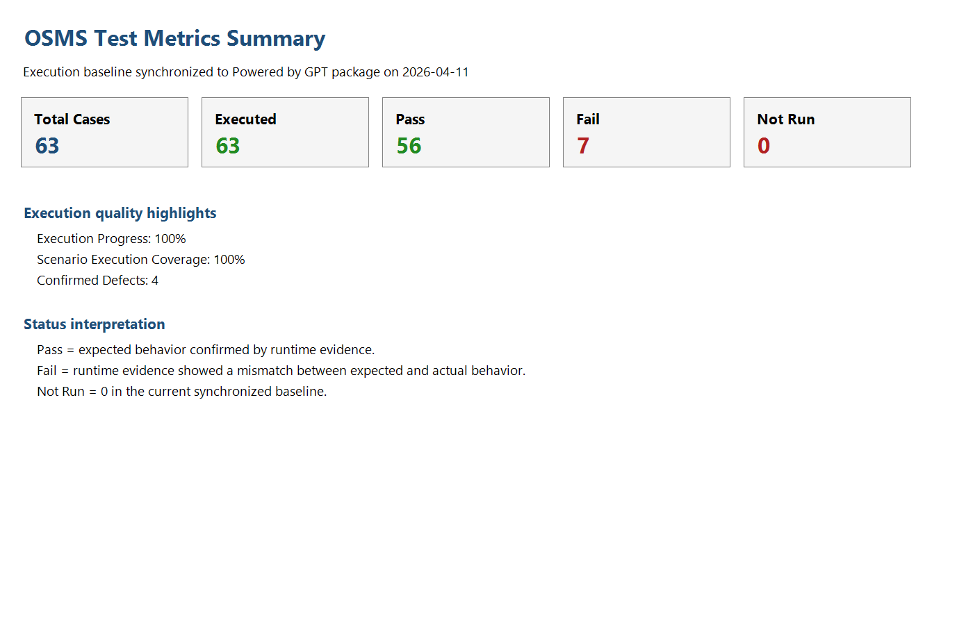
07 Metrics Snapshot
Execution Is Complete, Stability Is Not Yet Complete
The metrics separate test coverage from product quality so the conclusion stays rigorous and evidence-based.
63 / 63
56 pass
Executed cases
Pass rate 88.89%
7 fail
4 live issues
Fail rate 11.11%
Confirmed defects in GitHub
Interface view - Admin UI: 41 executed - API: 19 executed and fully passed - Public UI: 3 executed Interpretation 100% execution proves coverage, not defect-free behavior.
Metrics workbook snapshot as of 2026-04-11

Slide 9
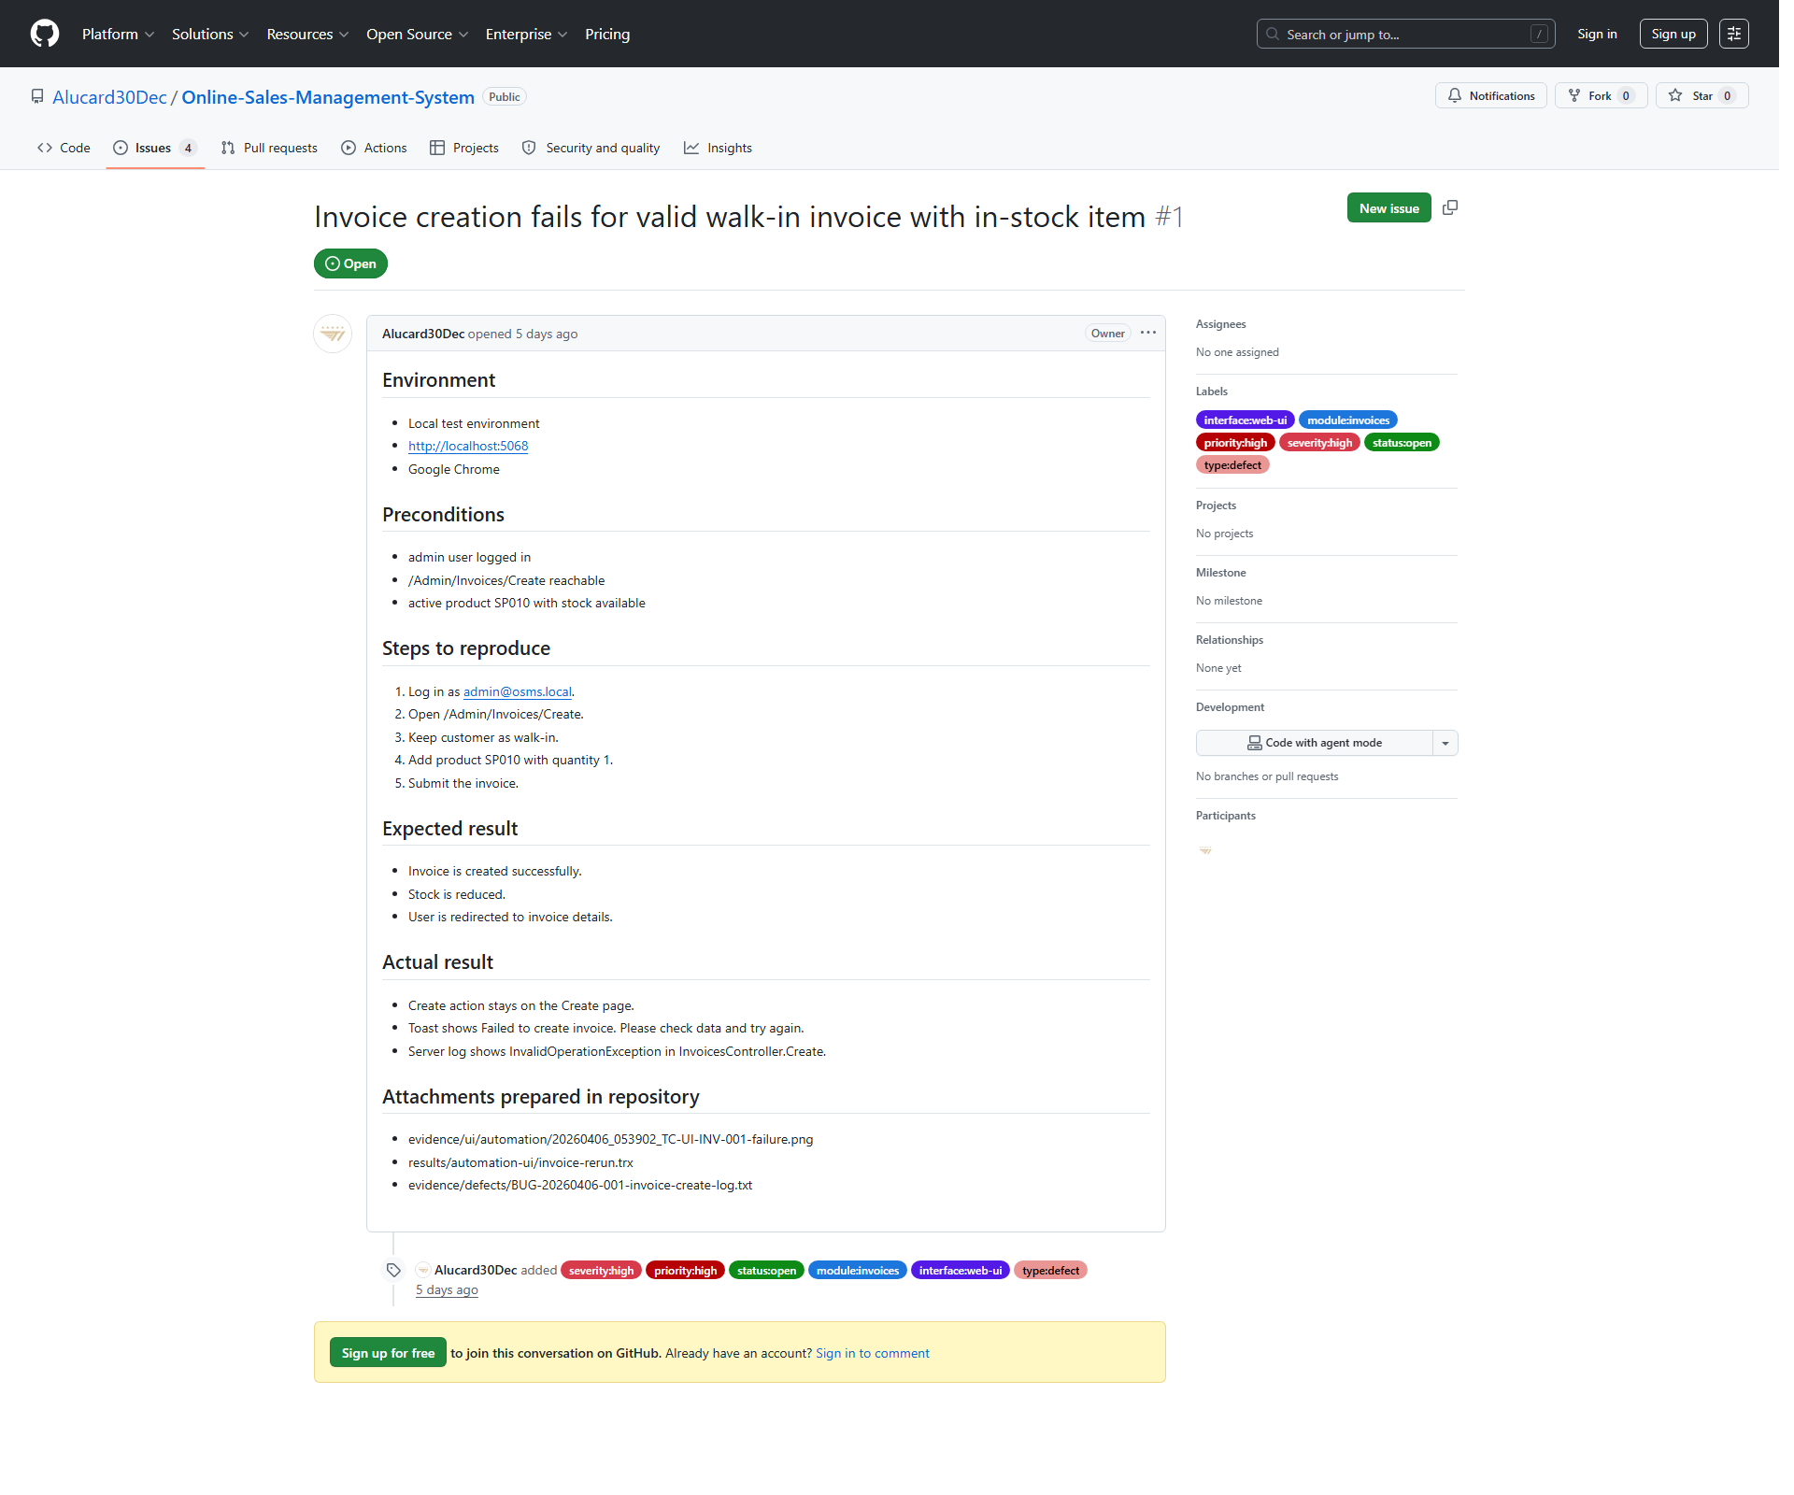
08 Defect Management
Defects Are Logged, Reproduced, And Linked To Live Issues
Each confirmed defect is supported by reproducible evidence and a live GitHub issue with visible severity and priority labels.
BUG-20260406-001 #1 Invoices | Sev High | Pri High Open - Confirmed
BUG-20260411-002 #2 Purchases | Sev Medium | Pri Medium Open - Confirmed
BUG-20260411-003 #3 Product Import | Sev High | Pri High Open - Confirmed
BUG-20260411-004 #4 Invoices | Sev High | Pri High Open - Confirmed
Representative GitHub issue with visible labels, severity, and priority
All four confirmed defects were rerun on 2026-04-11 and still reproduced. The severity split remains 3 High and 1 Medium.

Slide 10
09 Final Assessment
What Is Proven Today, And What Still Needs Code Fixes
The final assessment is intentionally split between what the evidence proves now and what depends on future product changes.
Proven today - clear linkage from scenario to issue tracker - 63 / 63 cases executed with 0 Not Run - automation demonstrates both pass and fail evidence - the submission package is complete and reviewable
Still open - 4 product defects remain unresolved - post-fix retest depends on code fixes - cross-browser proof is currently limited to the Edge smoke run - current execution shows stability risks in invoice and import flows
1
2
3
Fix invoice create and invoice cancel first
Fix purchase validation and import confirm
Rerun failed cases and attach post-fix evidence

Slide 11
10 Q&A Backup
Short Answers For The Most Likely Review Questions
This backup slide exists to keep the live defense calm, concrete, and evidence-based.
Q1. Why do 7 failed cases map to 4 defects?
Q2. How do you distinguish automation failure from product defect?
Q3. Why does 100% execution not mean a stable product?
Q4. Which module is riskiest right now?
Q5. What is the first post-fix retest priority?

